Slide 1
ASSIGNMENT
Mahasiswa wajib menstraslate Materi dibawah ini dengan menggunakan bahasa Indonesia
File translat berbentuk Power Point
Pengerjaan tugas selambat-lambatnya pukul 12:00 WIB

Slide 2
Chapter 2: Networks in Our Daily Lives
Networking Essentials
Notes:
Cisco Networking Academy Program
Networking Essentials
Chapter 2: Networks in Our Daily Lives

Slide 3
Chapter 2 - Sections & Objectives
2.1 Getting Online
Explain the basic requirements for getting online.
2.2 Other Network Considerations
Explain the importance of network representations.
2.3 Cabling and Media
Build an Ethernet cable.
Notes:
3

Slide 4
2.1 Getting Online
Notes:
Cisco Networking Academy Program
Networking Essentials
Chapter 2: Networks in Our Daily Lives

Slide 5
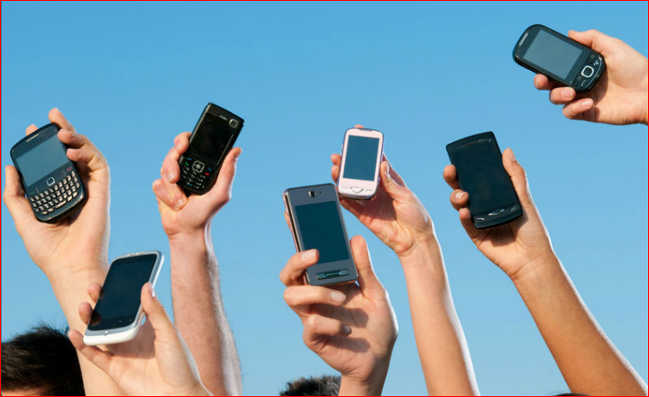
Getting Online Networks are Everywhere
Mobile phones use radio waves to transmit voice signals to antennas mounted on
towers located in specific geographic areas.
The abbreviations 3G, 4G, and 4G-LTE are used to describe enhanced cell phone
networks that are optimized for the fast transmission of data.
Other networks that are used by smart phones include GPS, Wi-Fi, Bluetooth, and
NFC.
Notes:
2.1 – Getting Online
2.1.1 – Networks are Everywhere

Slide 6
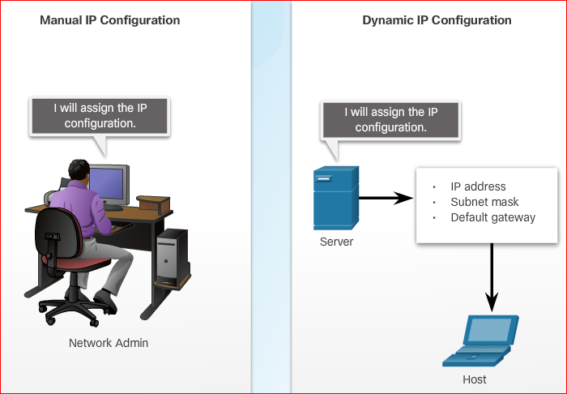
Getting Online Local Network Connections
Some examples of network components are personal computers, servers, networking
devices, and cabling. These components can be grouped into four categories: hosts,
shared peripherals, network devices, and network media.
There are three parts to the IP configuration which must be correct for the device to
send and receive information on the network:
IP address - identifies the host on the
network.
Subnet mask - identifies the
network on which the host is connected.
Default gateway - identifies the
networking device that the host uses to
access the Internet or another remote
network.
An IP address can be configured manually
or assigned automatically by another device.
Notes:
2.1 – Getting Online
2.1.2 – Local Network Connections

Slide 7
2.2 Other Network Considerations
Notes:
Cisco Networking Academy Program
Networking Essentials
Chapter 2: Networks in Our Daily Lives

Slide 8
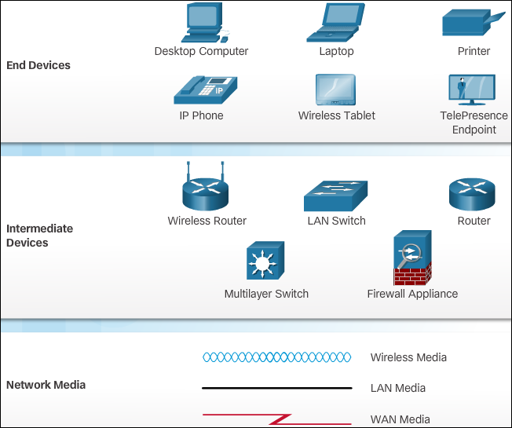
Other Network Considerations Keeping Track of it All
As a network grows in size and complexity, it is important that the network is well-planned, logically organized, and appropriately documented.
When networks are installed, a physical topology is created to record where each host is located and how it is connected to the network. The physical topology also shows where the wiring is installed and the locations of the networking devices that connect the hosts.
Notes:
2.2 – Other Network Considerations
2.2.1 – Keeping Track of it All

Slide 9
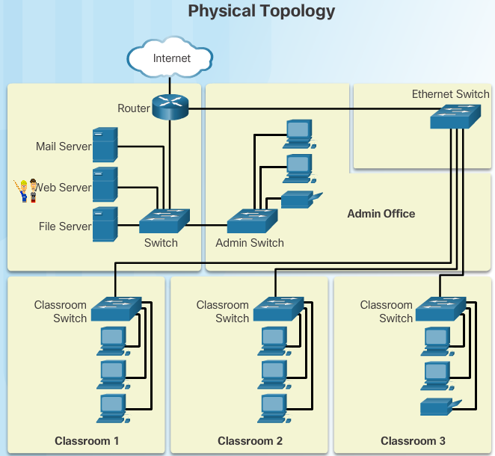
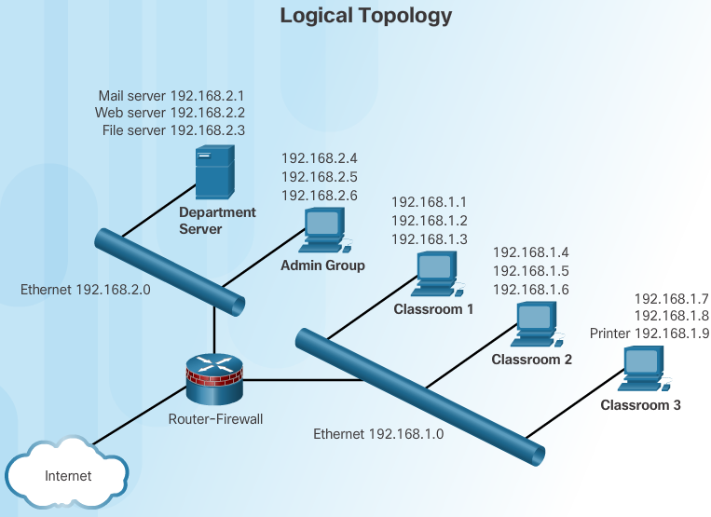
Other Network Considerations Keeping Track of it All
A logical topology illustrates the device names, IP addressing, configuration
information, and network designations. These are logical pieces of information that
may change more frequently than the physical topology of a network.
The icons in the image are used to create both physical and logical topologies.
Notes:
2.2 – Other Network Considerations
2.2.1 – Keeping Track of it All

Slide 10
2.3 Cabling and Media
Notes:
Cisco Networking Academy Program
Networking Essentials
Chapter 2: Networks in Our Daily Lives

Slide 11
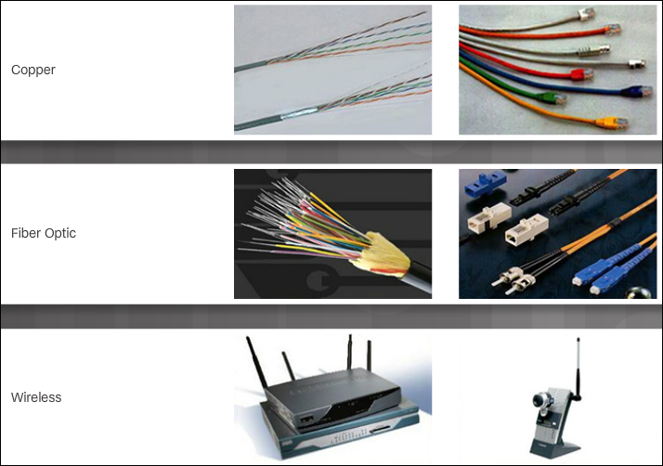
Cabling and Media Types of Network Media
Modern networks primarily use three types of media to interconnect devices and to provide the pathway over which data can be transmitted:
Copper wires within cables
Glass or plastic fibers (fiber-optic cable)
Wireless transmission
Twisted-Pair (TP) is a type of copper cable. TP is the most common type of
network cabling.
Coaxial Cable is usually made of copper or aluminum. It is used by cable
television companies to provide service, and for satellite communication systems.
Fiber-optic cables are made of glass or plastic. They have a very high bandwidth,
so they can carry vast amounts of data. Fiber-optic is used in backbone networks,
large enterprise environments, and large data centers.
Notes:
2.3 – Cabling and Media
2.3.1 – Types of Network Media

Slide 12
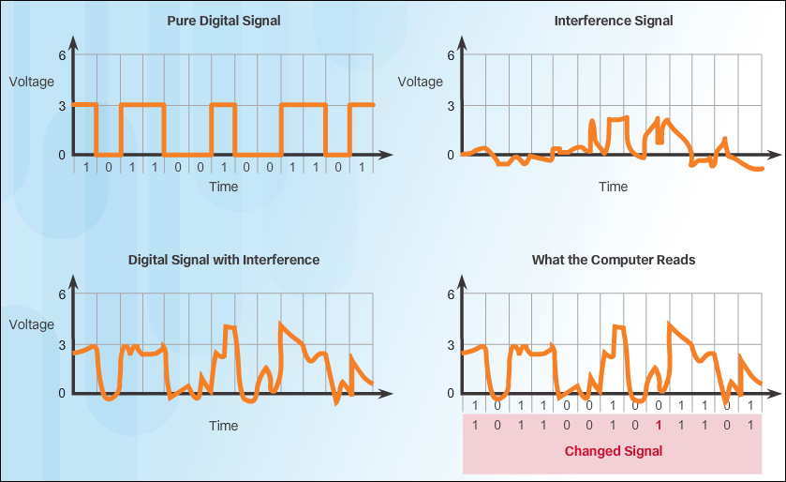
Cabling and Media Ethernet Cabling
Data transmission over copper cable is sensitive to electromagnetic interference
(EMI), which can reduce the data throughput rate. Another source of interference,
known as crosstalk, occurs when long lengths of cables are bundled together. The
electrical impulses from one cable may cross over to an adjacent cable.
There are two commonly installed types of twisted-pair cable: Unshielded
twisted-pair (UTP) and Shielded twisted-pair (STP).
Notes:
2.3 – Cabling and Media
2.3.2 – Ethernet Cabling

Slide 13
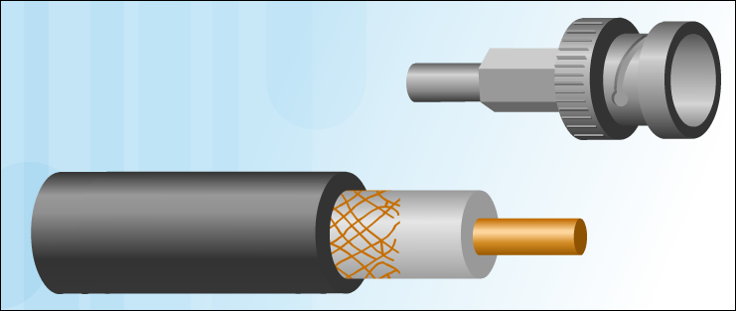
Cabling and Media Other Types of Network Cabling
Like twisted-pair, coaxial cable (or coax) carries data in the form of electrical signals. It has better shielding than UTP and can carry more data. Coaxial cable is usually constructed of either copper or aluminum.
Fiber-optic cable is constructed of either glass or plastic, neither of which conducts electricity. It is immune to EMI and RFI, and is suitable for installation in environments where interference is a problem.
Notes:
2.3 – Cabling and Media
2.3.3 – Other Types of Network Cabling

Slide 14
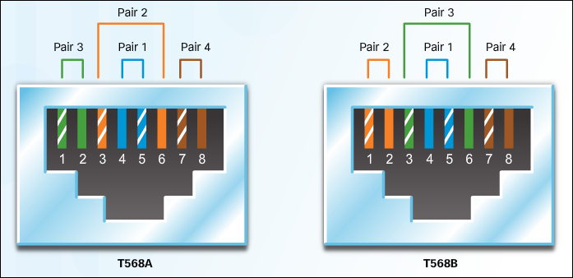
Cabling and Media Do the Colors Matter?
There are two wiring schemes, called T568A and T568B. Each wiring scheme defines the pinout, or order of wire connections, on the end of the cable.
Ethernet NICs and ports on networking devices send data over UTP cables. Specific pins on the connector are associated with a transmit function and a receive function. The interfaces on each device transmit and receive data on designated wires within the cable.
Notes:
2.3 – Cabling and Media
2.3.4 – Do the Colors Matter?

Slide 15


Slide 16


